Slide 1
Standard test signals,
Time Response Analysis of first and second order Systems

Slide 2
Unit 1: Revision
Types of control system
Effect of Feedback
Mathematical modeling
Block diagram algebra
Signal flow graph and Massion’s gain formula and Transfer function

Slide 3



Objective
How to know the performance of a control system for any input signal?
How to design a control system which meets the desired response and control requirements ?
Time Domain Analysis and Design Specifications

Slide 4
Time Domain Analysis
Time domain analysis refers to the analysis of system performance in time i.e., the study of evolution of system variables (specifically output) with time

Slide 5
System Response
Transient response
It is depend on system poles only and not on type of input
Steady state response
It is depends on both type of input and location of system poles
Natural response
Depends on initial condition only assuming Input = 0
Forced response
Depends on input only assuming all initial condition = 0
In both cases, the complete response of the system is given by the combination of both responses i.e., natural and forced responses or transient and steady state responses

Slide 6
System Response
Natural response
Depends on initial condition only assuming Input = 0
Forced response
Depends on input only assuming all initial condition = 0
In both cases, the complete response of the system is given by the combination of both responses i.e., natural and forced responses

Slide 7
Natural and Forced Responses
Natural response (Zero input response) :
System's response to initial conditions with all external forces set to zero
E.g. In RLC circuits, this would be the response of the circuit to initial conditions (inductor currents or capacitor voltages) with all the independent voltage and current sources set to zero

Slide 8
Natural and Forced Responses
Forced response (Zero state response) :
System's response to external forces with zero initial conditions
E.g. In RLC circuits, this would be the response of the circuit to only external voltage and current source, and zero initial conditions

Slide 9
Transient and Steady State Responses
Transient response 𝒚_{𝒕𝒓}(𝒕): Part of the time response that goes to zero as time tends to be large
It is depend on system poles only and not on type of input
Steady state response 𝒚_{𝒔𝒔}(𝒕):
– Steady state response is the time response of a system after transient
practically vanishes and as time goes to infinite
It is depends on both type of input and location of system poles
Total Time response y(t)= 𝑦_{𝑡r}(𝑡) +𝑦_{𝑠𝑠} (𝑡)

Slide 10
Transient and Steady State Responses
Transient response 𝒚_{𝒕𝒓}(𝒕):
Part of the time response that goes to zero as time tends to be large
Transient response can be tied to any event that affects the equilibrium
of a system viz. switching, disturbance, change in input, etc.
It is depend on system poles only and not on type of input
lim 𝑦_{𝑡𝑟} (𝑡) = 0
𝑡→∞
Steady state response 𝒚_{𝒔𝒔}(𝒕):
– Steady state response is the time response of a system after transient
practically vanishes and as time goes to infinite
It is depends on both type of input and location of system poles
y(t)= 𝑦_{𝑡r}(𝑡) +𝑦_{𝑠𝑠} (𝑡)

Slide 11
Standard Test Inputs
In most cases, the input signals to a control system are not known prior to design of control system
Hence to analyse the performance of a control system, it is excited with standard test signals
In general, control system design specifications are also based on the response of the system to such test signals

Slide 12
Standard Test Inputs
Standard test signals include:
Unit impulse,
unit step (sudden change),
ramp (constant velocity),
parabolic (constant acceleration) and
sinusoidal
These inputs are chosen because they capture many of the possible variations that can occur in an arbitrary input signal

Slide 13
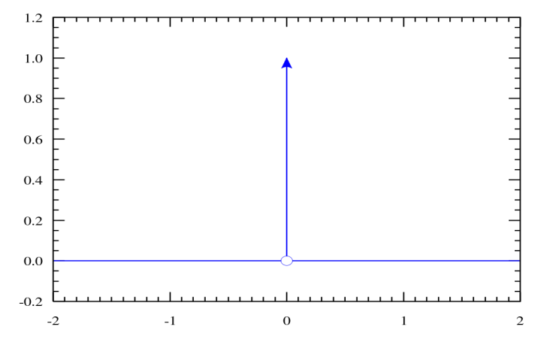

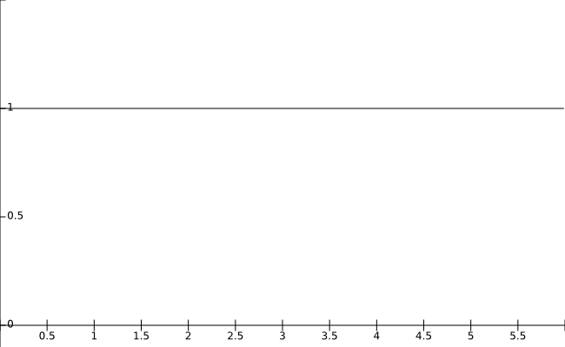

Standard Test Inputs
Unit impulse signal:
– A signal which is non-zero only at 𝑡 = 0
and integrates to one
∞
𝛿 𝑡 = 1
𝛿 𝑡
−∞
ℒ 𝛿 𝑡 = 1
Unit step signal:
𝑡
– A signal that switches to one at a time instant and stays there indefinitely
1 ; 𝑡 > 0
𝑥 𝑡
𝑥 𝑡 =
0 ; 𝑡 < 0
1
ℒ 𝑥 𝑡 = _{𝑠}
8
𝑡

Slide 14
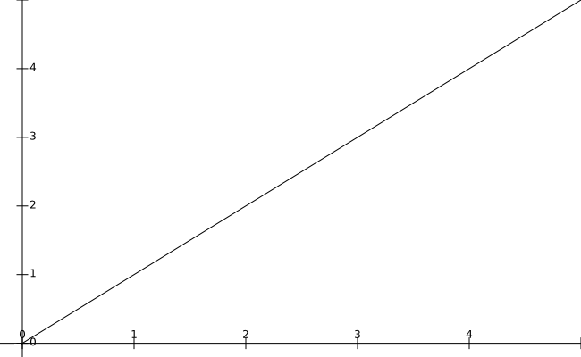

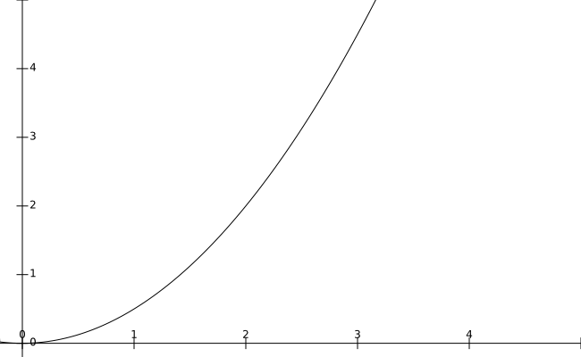

Standard Test Inputs
Ramp signal:
– A signal which increases linearly with time
𝐴𝑡 ;𝑡 ≥ 0
𝑥 𝑡
𝑥 𝑡 =
0 ; 𝑡 < 0
𝐴
= _{𝑠2}
ℒ 𝑥 𝑡
𝑡
Parabolic signal:
𝐴𝑡²
𝑥 𝑡
𝑥 𝑡 =
; 𝑡 ≥ 0
2
0 ; 𝑡 < 0
𝐴
ℒ 𝑥 𝑡 = _{𝑠3}
𝑡

Slide 15
First order System

Slide 16










1st Order Systems
Systems with only one pole are called 1st order systems
𝑅(𝑠)
1
𝜏𝑠
𝑌(𝑠)
+
𝑌 𝑠
𝑇𝐹 = _{𝑅 𝑠}
1
⁼ 𝜏𝑠 + 1
−
1
𝝉: System time constant
– It characterizes the speed of
response of a system to an input
– Higher the time constant, slower the response and vice-versa
Standard block diagram of a 1st order system

Slide 17
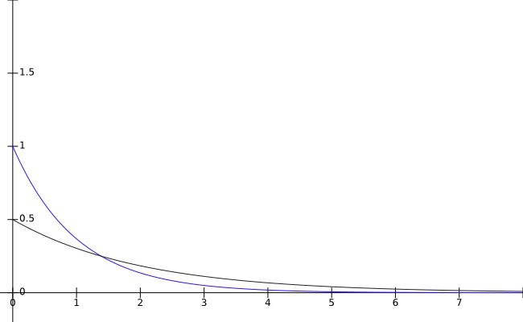


Impulse Response of 1st Order Systems
Unit impulse: 𝑅 𝑠 = 1
𝑟 𝑡 , 𝑦(𝑡)
1 1
𝑌 𝑠 =
𝑅 𝑠 =
𝜏𝑠 + 1 𝜏𝑠 + 1
1
₋ 𝑡
−1
𝑦 𝑡 = ℒ 𝑌 𝑠 = 𝑒
𝜏
𝜏
𝜏 is the time constant of the system
_{𝜏} 𝑒 ^{𝜏} is the transient term 𝑦_{𝑡𝑟} (𝑡) while
𝑡
𝑟 𝑡 and 𝑦(𝑡) when 𝜏 = 1, 𝜏 = 2
1
₋ 𝑡
the steady state term 𝑦_{𝑠𝑠} 𝑡 = 0

Slide 18
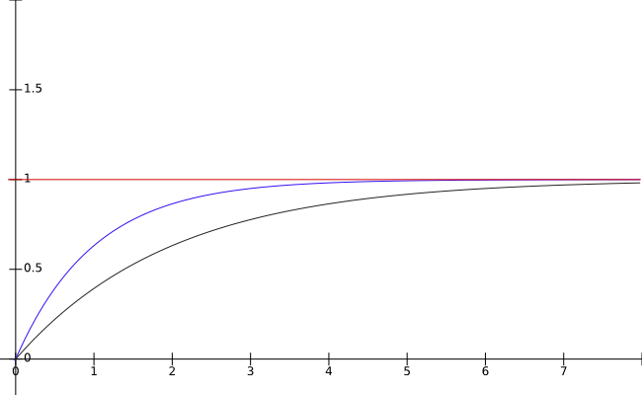

Step Response of 1st Order Systems
Unit step: 𝑅 𝑠 =
1
𝑠
𝑟 𝑡 𝑦(𝑡)
1
⁼ 𝜏𝑠 + 1 ^{𝑅 𝑠}
1 𝜏
1
⁼ 𝑠(𝜏𝑠 + 1)
𝑌 𝑠
⁼ 𝑠 ⁻ 𝜏𝑠 + 1
₋𝑡
−1
𝑦 𝑡 = ℒ 𝑌 𝑠 = 1 − 𝑒
𝜏
𝑡
₋𝑡
In this case, 𝑦_{𝑡𝑟} t = −𝑒 𝜏 and 𝑦_{𝑠𝑠} 𝑡 = 1
𝑟 𝑡 and 𝑦(𝑡) when 𝜏 = 1, 𝜏 = 2

Slide 19
TIME RESPONSE

Slide 22
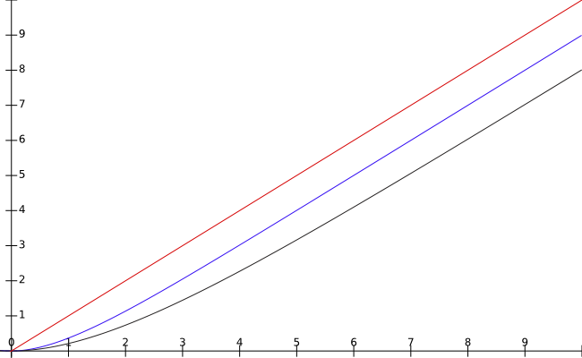

Ramp Response of 1st Order Systems
1
Unit ramp: 𝑟 𝑡 = 𝑡 ⟹ 𝑅 𝑠 =
_{𝑠}2
𝑟 𝑡 , 𝑦(𝑡)
1
⁼ 𝜏𝑠 + 1 ^{𝑅 𝑠}
1 𝜏
1
⁼ 𝑠²(𝜏𝑠 + 1)
𝑌 𝑠
_{𝜏}2
⁼ 𝑠² ⁻ 𝑠 ⁺ 𝜏𝑠 + 1
₋𝑡
𝑦 𝑡 = ℒ
−1
𝑌 𝑠 = 𝑡 − 𝜏 + 𝜏𝑒
𝜏
𝑡
𝑦𝑡𝑟
₋ 𝑡
𝑡 = 𝜏𝑒
𝜏
; 𝑦_{𝑠𝑠} 𝑡 = 𝑡 − 𝜏
𝑟 𝑡 and 𝑦(𝑡) when 𝜏 = 1, 𝜏 = 2

Slide 23
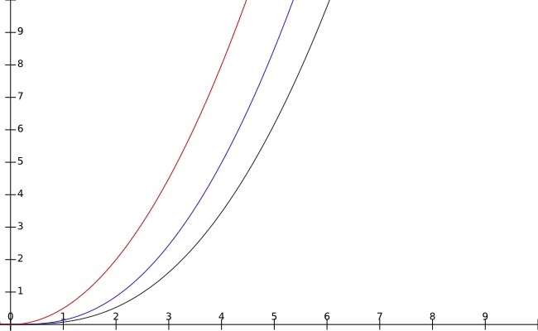


Parabolic Response of 1st Order Systems
_{𝑡} 2
1
Unit parabolic: 𝑟 𝑡 = ⟹ 𝑅 𝑠 =
2 𝑠³
𝑟 𝑡 , 𝑦(𝑡)
1
⁼ 𝜏𝑠 + 1 ^{𝑅 𝑠}
1 𝜏
1
⁼ 𝑠³(𝜏𝑠 + 1)
_{𝜏}2 _{𝜏}3
𝑌 𝑠
⁼ 𝑠³ ⁻ 𝑠² ⁺ 𝑠 ⁻ 𝜏𝑠 + 1
_{𝑡}2
2
𝑡
𝑡
𝑦 𝑡 = ℒ
−1
𝑌 𝑠 =
− 𝜏𝑡 + 𝜏² − 𝜏²𝑒
−
𝜏
𝑟 𝑡 and 𝑦(𝑡) when 𝜏 = 1, 𝜏 = 2
_{𝑡}2
𝑡 = −𝜏 𝑒 𝜏 ; y_{𝑠𝑠} 𝑡 = ₂ − 𝜏𝑡 + 𝜏
𝑦 𝑡𝑟
₋ 𝑡
2
2

Slide 24
Second order systems

Slide 25
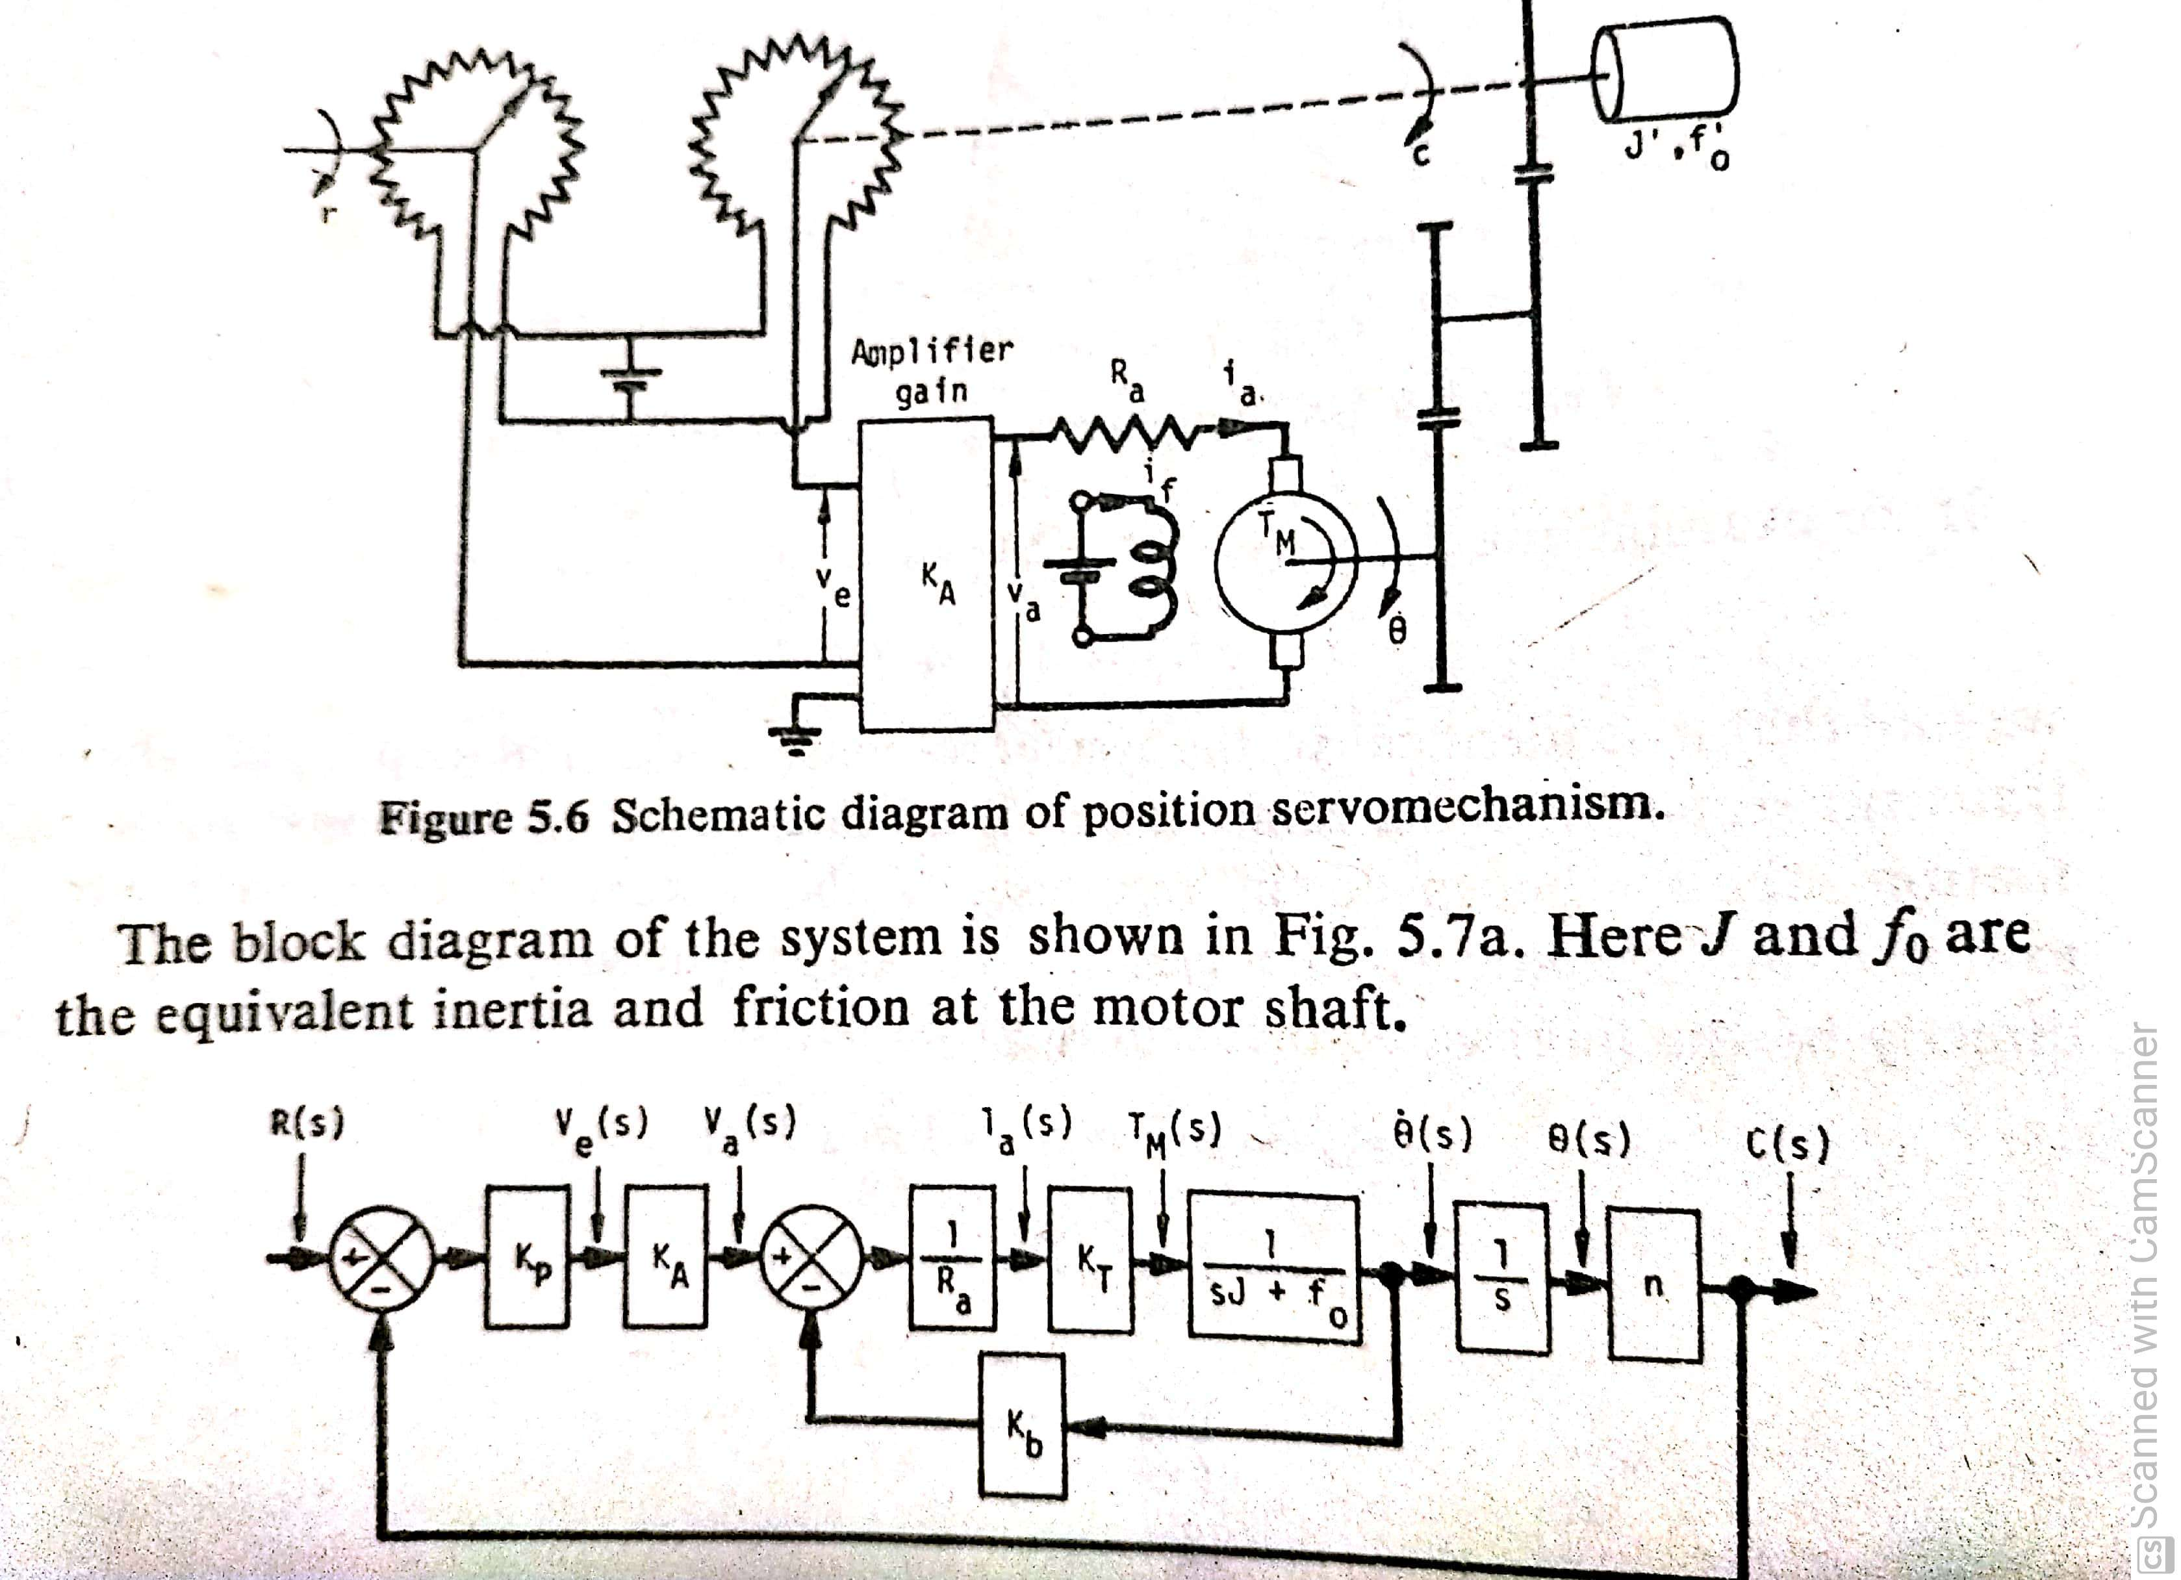
Second order systems

Slide 26
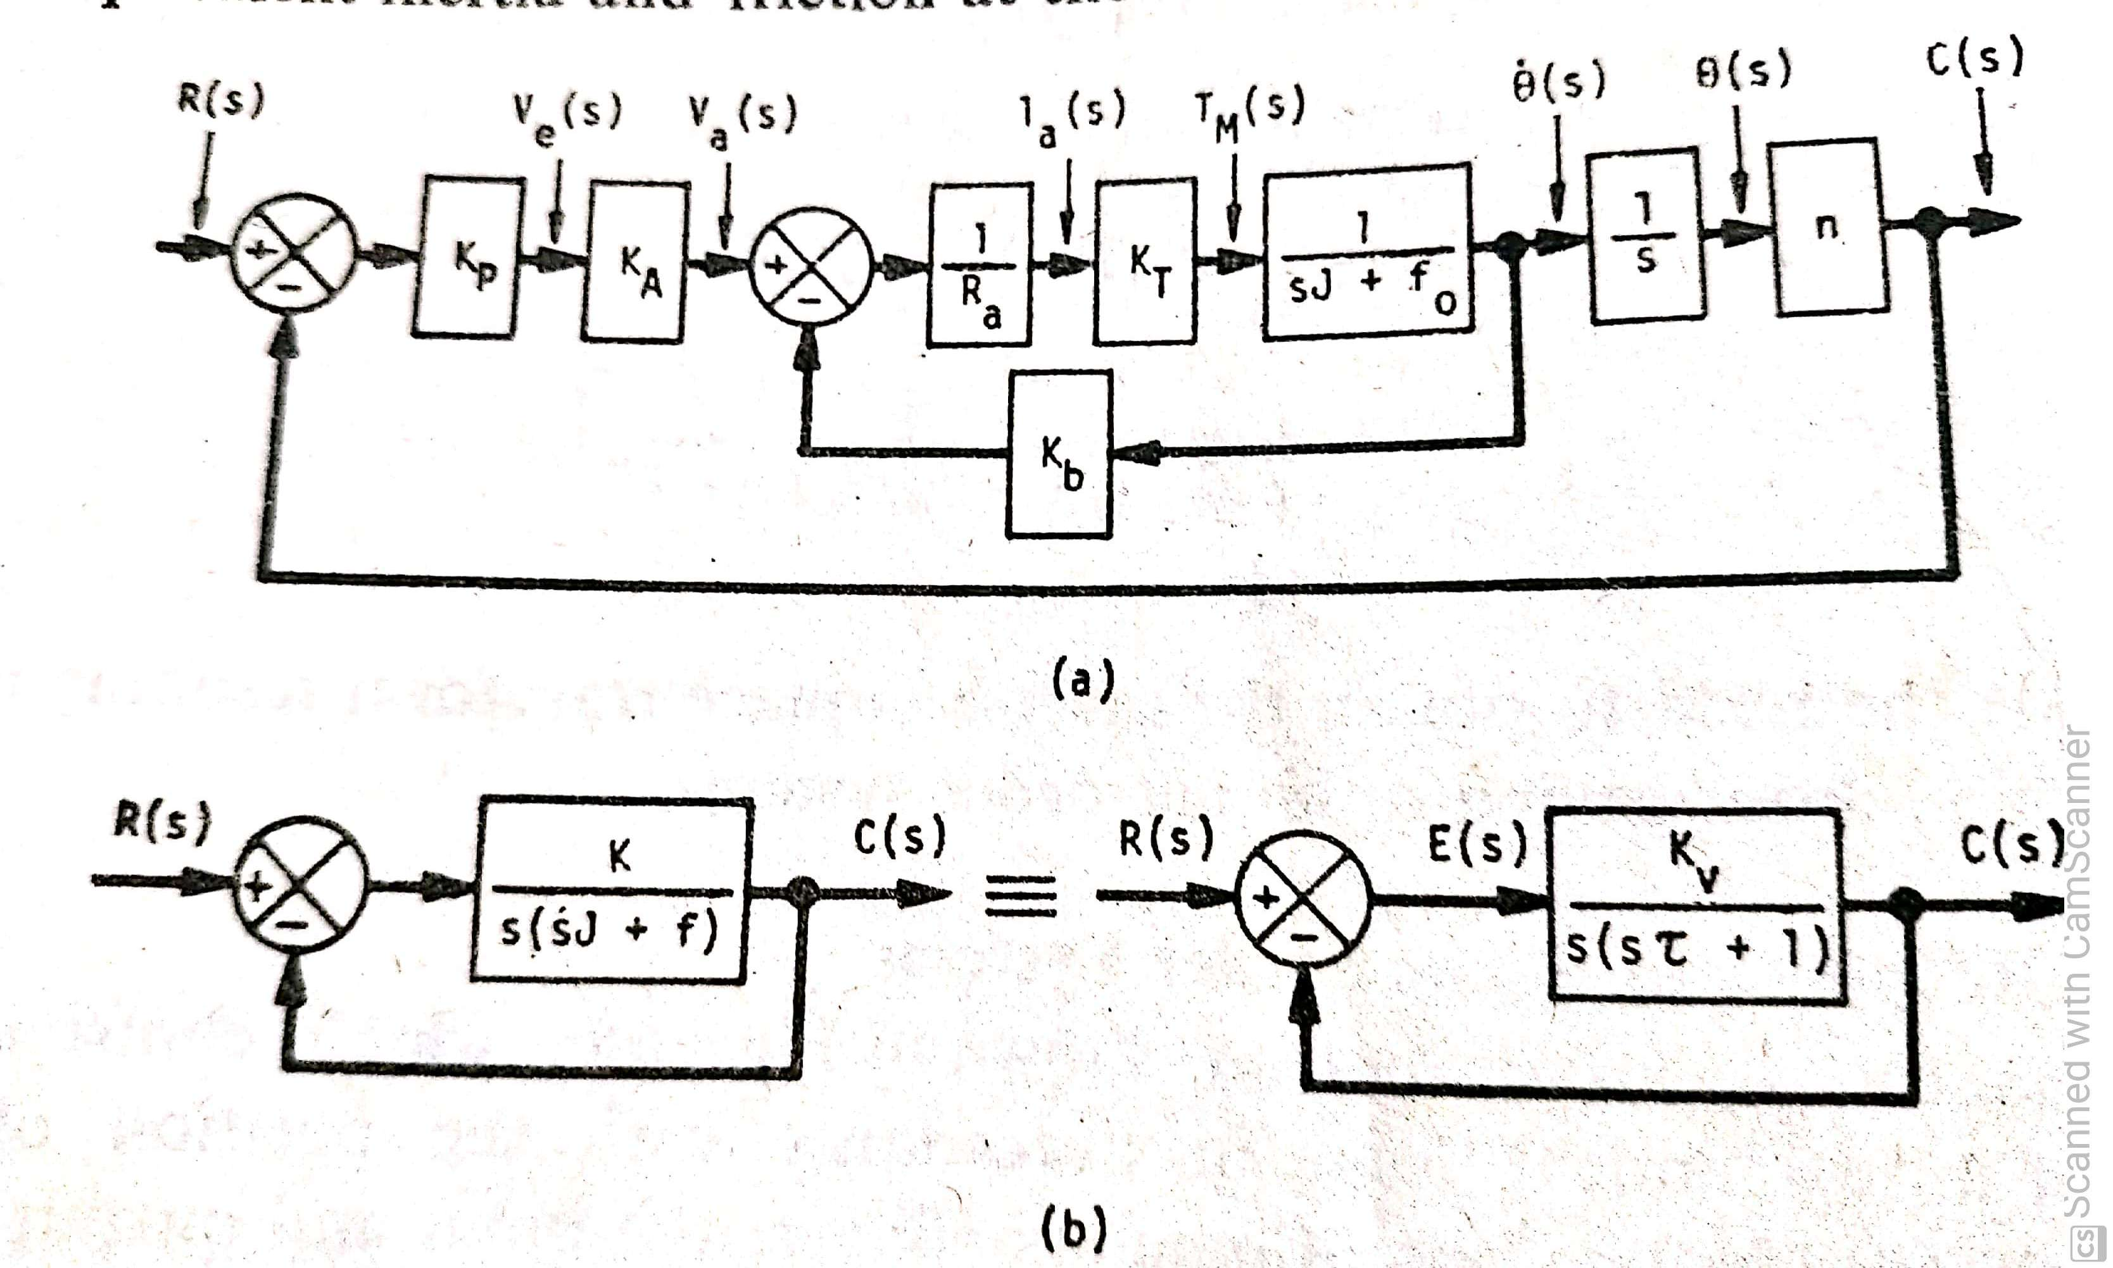
Second order systems

Slide 27










Standard Form of 2nd Order System
_{𝜔}2
𝑌(𝑠)
𝑌 𝑠
𝑅 𝑠
_{𝜔}2
𝑅(𝑠)
𝑛
+
𝑛
𝑇𝐹 =
=
−
𝑠(𝑠 + 2𝜁𝜔 )
𝑠² + 2𝜁𝜔_{𝑛}𝑠 + 𝜔²
𝑛
𝑛
Standard form of transfer function
1
𝜔_{𝑛}: System natural frequency
𝜁: System damping ratio
Block diagram of a 2nd order system

Slide 28
Important System Parameters
System damping ratio 𝜁: a dimensionless quantity describing the decay of oscillations during a transient response
It is the ratio of actual damping to critical damping of a system
System natural frequency 𝜔_{𝑛}: angular frequency at which system
tends to oscillate in the absence of damping force
System damped frequency 𝜔_{𝑑}: angular frequency at which system tends to oscillate in the presence of damping force
𝜔_{𝑑} = 𝜔_{𝑛} 1 − 𝜁²

Slide 29
Second order system

Slide 32
Response of 2nd Order Systems
Response of 2nd order systems mainly depends on the damping ratio 𝜁
For any test input, the response of a 2nd order system can be studied in four cases depending on the damping effect created by value of 𝜁:
𝜁 > 1: Overdamped system
𝜁 = 1: Critically damped system
0 < 𝜁 < 1: Underdamped system
𝜁 = 0: Undamped system
Note: We do not consider negative damping ratio 𝜁 because negative damping actually means the oscillations are increasing in amplitude which results in unstable systems

Slide 33
Damping and Types of Damping
Damping is an effect created in an oscillatory system that reduces, restricts or prevents the oscillations in the system
Systems can be classified as follows depending on damping effect:
Overdamped systems: Transients in the system exponentially decays to steady state without any oscillations
Critically damped systems: Transients in the system decay to steady state without any oscillations in shortest possible time
Underdamped systems: System transients oscillate with the amplitude of oscillation gradually decreasing to zero
Undamped systems: System keeps on oscillating at its natural
frequency without any decay in amplitude

Slide 34
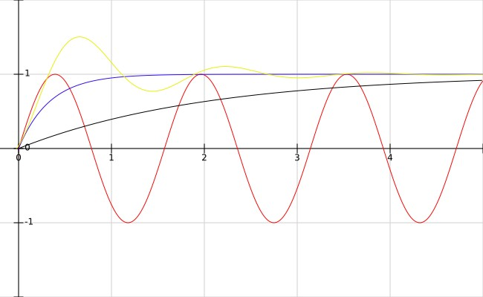
Types of Damping
Underdamped
Critically damped
Overdamped
𝑦(𝑡)
Undamped
Control Systems
2
𝑡
20

Slide 35
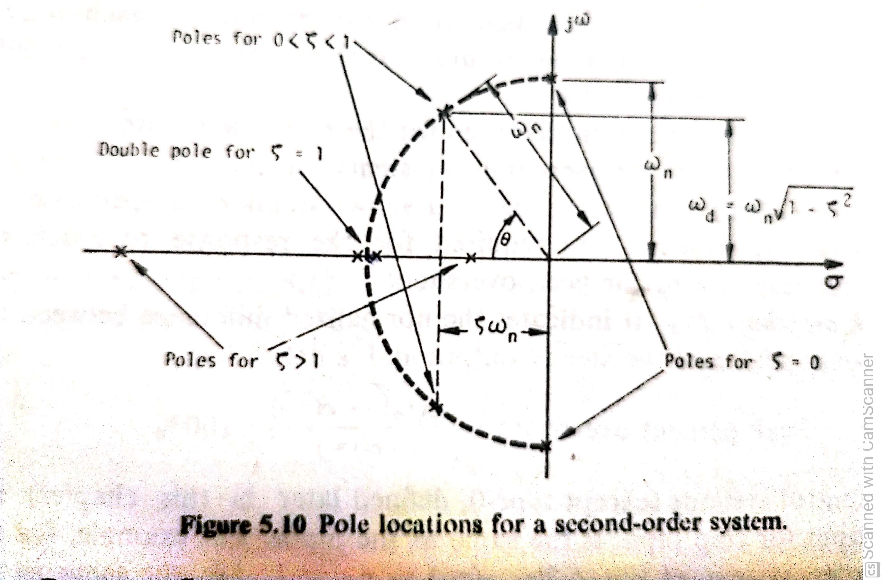
Second order systems

Slide 36
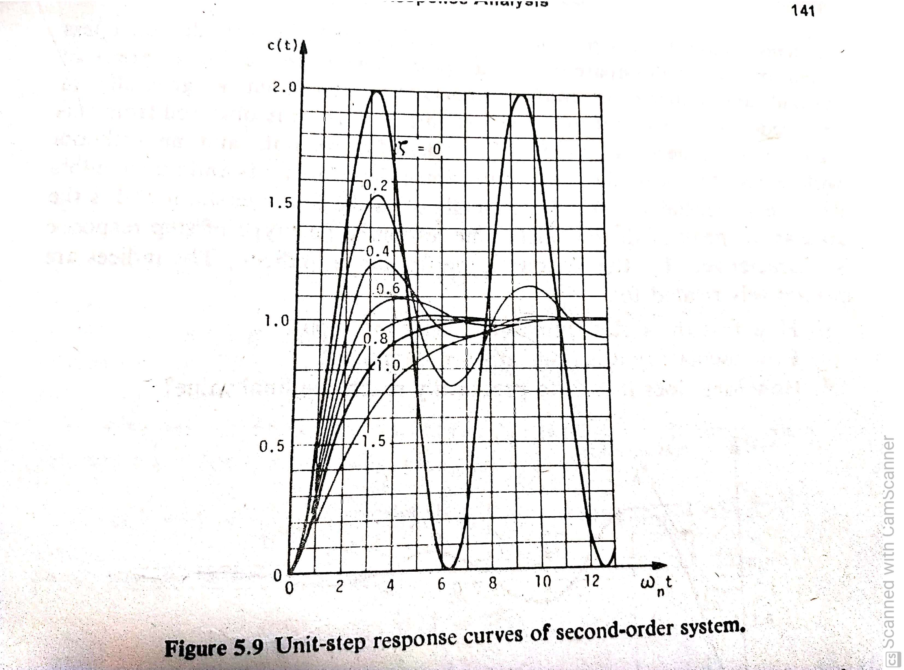
Second order systems

Slide 37
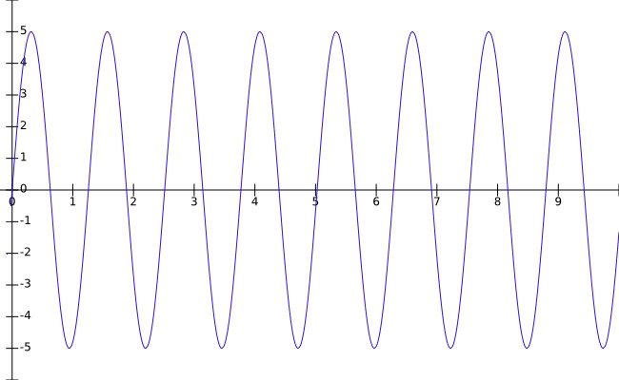
Impulse Response of 2nd
Order Systems
Unit impulse: 𝑅 𝑠 = 1
𝑦(𝑡)
_{𝜔}2
₌ 𝑛
𝑌 𝑠
𝑠² + 2𝜁𝜔_{𝑛}𝑠 + 𝜔²
𝑛
Case 1: 𝜁 = 0 − Undamped system
_{𝜔}2
₌ 𝑛
𝑡
𝑌 𝑠
𝑠² + 𝜔²
𝑛
𝑦(𝑡) when 𝜁 = 0, 𝜔_{𝑛} = 5
𝑦 𝑡 = ℒ⁻¹ 𝑌 𝑠
= 𝜔_{𝑛} sin(𝜔_{𝑛}𝑡)
37

Slide 38
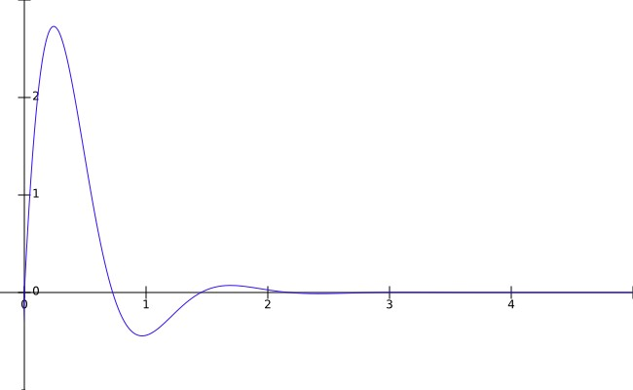
Impulse Response of 2nd
Order Systems
Case 2: 0 < 𝜁 < 1 − Underdamped system
_{𝜔}2
₌ 𝑛
𝑦(𝑡)
𝑌 𝑠
𝑠² + 2𝜁𝜔_{𝑛}𝑠 + 𝜔²
𝑛
_{𝜔}2
𝑦 𝑡
_{= ℒ}−1
𝑛
(𝑠 + 𝜁𝜔_{𝑛} − 𝑗𝜔_{𝑑})(𝑠 + 𝜁𝜔_{𝑛} + 𝑗𝜔_{𝑑})
𝜔_{𝑛}
𝜔
1 − 𝜁²
𝑑
_{= ℒ}−1
2
𝑡
𝑠 + 𝜁𝜔_{𝑛} ² + (𝜔_{𝑑})
𝜔_{𝑛}
𝑦(𝑡) when 𝜁 = 0.5, 𝜔_{𝑛} = 5
𝑦 𝑡 =
𝑒^{−𝜁𝜔𝑛𝑡} sin(𝜔 𝑡)
1 − 𝜁²
𝑑
38

Slide 39
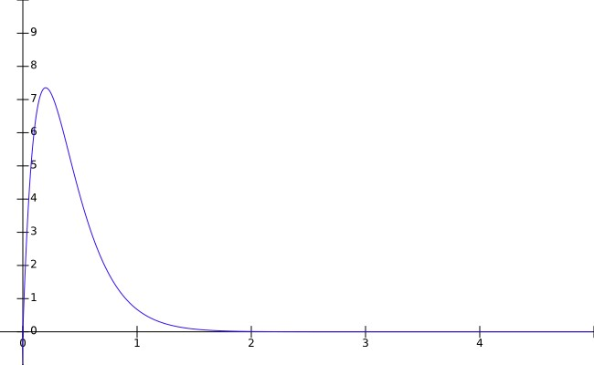
Impulse Response of 2nd
Order Systems
Case 3: 𝜁 = 1 − Critically damped system
_{𝜔}2
𝑦(𝑡)
₌ 𝑛
𝑌 𝑠
𝑠² + 2𝜔_{𝑛}𝑠 + 𝜔²
𝑛
_{𝜔}2
𝑦 𝑡
_{= ℒ}−1
𝑛
𝑠 + 𝜔_{𝑛}
2
𝑦 𝑡
_{= 𝜔}2_{𝑡𝑒}−𝜔_{𝑛}𝑡
𝑛
𝑡
𝑦(𝑡) when 𝜁 = 1, 𝜔_{𝑛} = 5
39

Slide 40
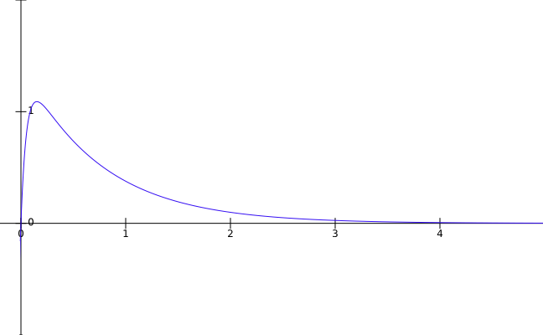
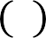
Impulse Response of 2nd
Order Systems
Case 4: 𝜁 > 1 − Overdamped system
_{𝜔}2
𝑦(𝑡)
₌ 𝑛
𝑌 𝑠
𝑠 ² + 2𝜁𝜔_{𝑛}𝑠 + 𝜔²
𝑛
𝑦 𝑡
_{𝜔}2
_{= ℒ}−1
𝑛
(𝑠 + 𝜁𝜔_{𝑛} − 𝜔_{𝑛}
𝜁² − 1)(𝑠 + 𝜁𝜔_{𝑛} + 𝜔_{𝑛}
𝜁² − 1)
𝜔_{𝑛}
𝑡
𝑦 𝑡 =
𝑒
−(𝜁𝜔 −𝜔 𝜁²−1)𝑡
𝑛 𝑛
2 𝜁² − 1
𝑦(𝑡) when 𝜁 = 2, 𝜔_{𝑛} = 5
𝜔_{𝑛}
_{𝑒}−(𝜁𝜔_{𝑛}+𝜔_{𝑛} 𝜁²−1)𝑡
−
2 𝜁² − 1
40

Slide 41
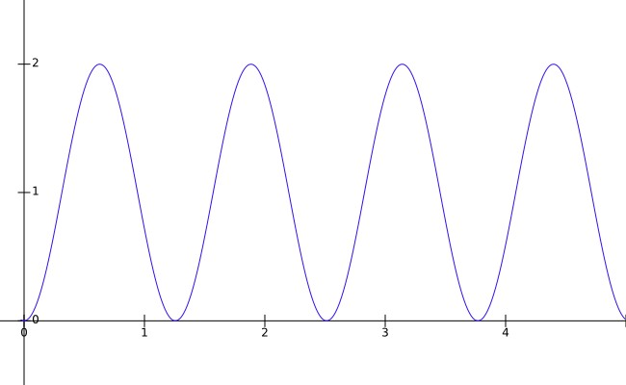

Step Response of 2nd
Order Systems
1
𝑠
Unit step: 𝑅 𝑠 =
𝑟 𝑡 , 𝑦(𝑡)
_{𝜔}2
₌ 𝑛
𝑌 𝑠
𝑠(𝑠² + 2𝜁𝜔_{𝑛}𝑠 + 𝜔²)
𝑛
Case 1: 𝜁 = 0 − Undamped system
_{𝜔}2
𝑡
𝑟(𝑡) and 𝑦(𝑡) when 𝜁 = 0, 𝜔 = 5
1 𝑠
𝑠 𝑠² − 𝜔²
₌ 𝑛 ₌
𝑌 𝑠
−
𝑠(𝑠² + 𝜔²)
𝑛
𝑛
𝑛
𝑦 𝑡 = ℒ⁻¹ 𝑌 𝑠
= 1 − cos(𝜔_{𝑛}𝑡)
41

Slide 42
Step Response of 2nd
Order Systems
Case 2: 0 < 𝜁 < 1 − Underdamped system
_{𝜔}2
1
𝑠 𝑠 ² + 2𝜁𝜔 𝑠 + 𝜔²
₌ 𝑛
_{= ℒ}−1
𝑠 + 2𝜁𝜔
𝑌 𝑠
⟹ 𝑦 𝑡
−
𝑛
𝑠(𝑠 ² + 2𝜁𝜔_{𝑛}𝑠 + 𝜔²)
𝑛
𝜔_{𝑑}
𝑛
𝑛
1 − 𝜁²
𝜁𝜔_{𝑛}
1
𝑠 + 𝜁𝜔_{𝑛}
1 − 𝜁²
= ℒ
−1
−
−
𝑠 𝑠 + 𝜁𝜔
2 ₊
_{𝜔}2
𝑠 + 𝜁𝜔
² + 𝜔²
𝑛
𝑑
𝑛
𝑑
𝜁
𝑦 𝑡 = 1 − 𝑒^{−𝜁𝜔𝑛𝑡} cos 𝜔 𝑡 −
𝑒^{−𝜁𝜔𝑛𝑡} sin(𝜔 𝑡)
𝑑
𝑑
1 − 𝜁²
_{𝑒}−𝜁𝜔_{𝑛}𝑡
𝑦 𝑡 = 1 −
1 − 𝜁²
cos 𝜔_{𝑑} 𝑡
+ 𝜁 sin 𝜔_{𝑑} 𝑡
1 − 𝜁²
42

Slide 43
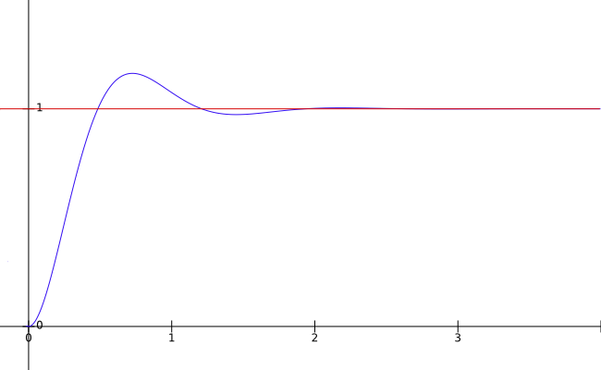


Step Response of 2nd Order Systems
_{𝑒}−𝜁𝜔_{𝑛}𝑡
𝑦 𝑡 = 1 −
[sin𝜃 cos 𝜔_{𝑑}𝑡 + cos 𝜃 sin 𝜔_{𝑑}𝑡
1 − 𝜁²
_{𝑒}−𝜁𝜔_{𝑛}𝑡
𝑦 𝑡 = 1 −
sin(𝜔_{𝑑}𝑡 + 𝜃)
1 − 𝜁²
𝑟 𝑡 , 𝑦(𝑡)
where 𝜃 = cos⁻¹ 𝜁 = sin⁻¹
1 − 𝜁²
𝑡
𝑟 𝑡 and 𝑦(𝑡) when 𝜁 = 0.5, 𝜔_{𝑛} = 5
43

Slide 44
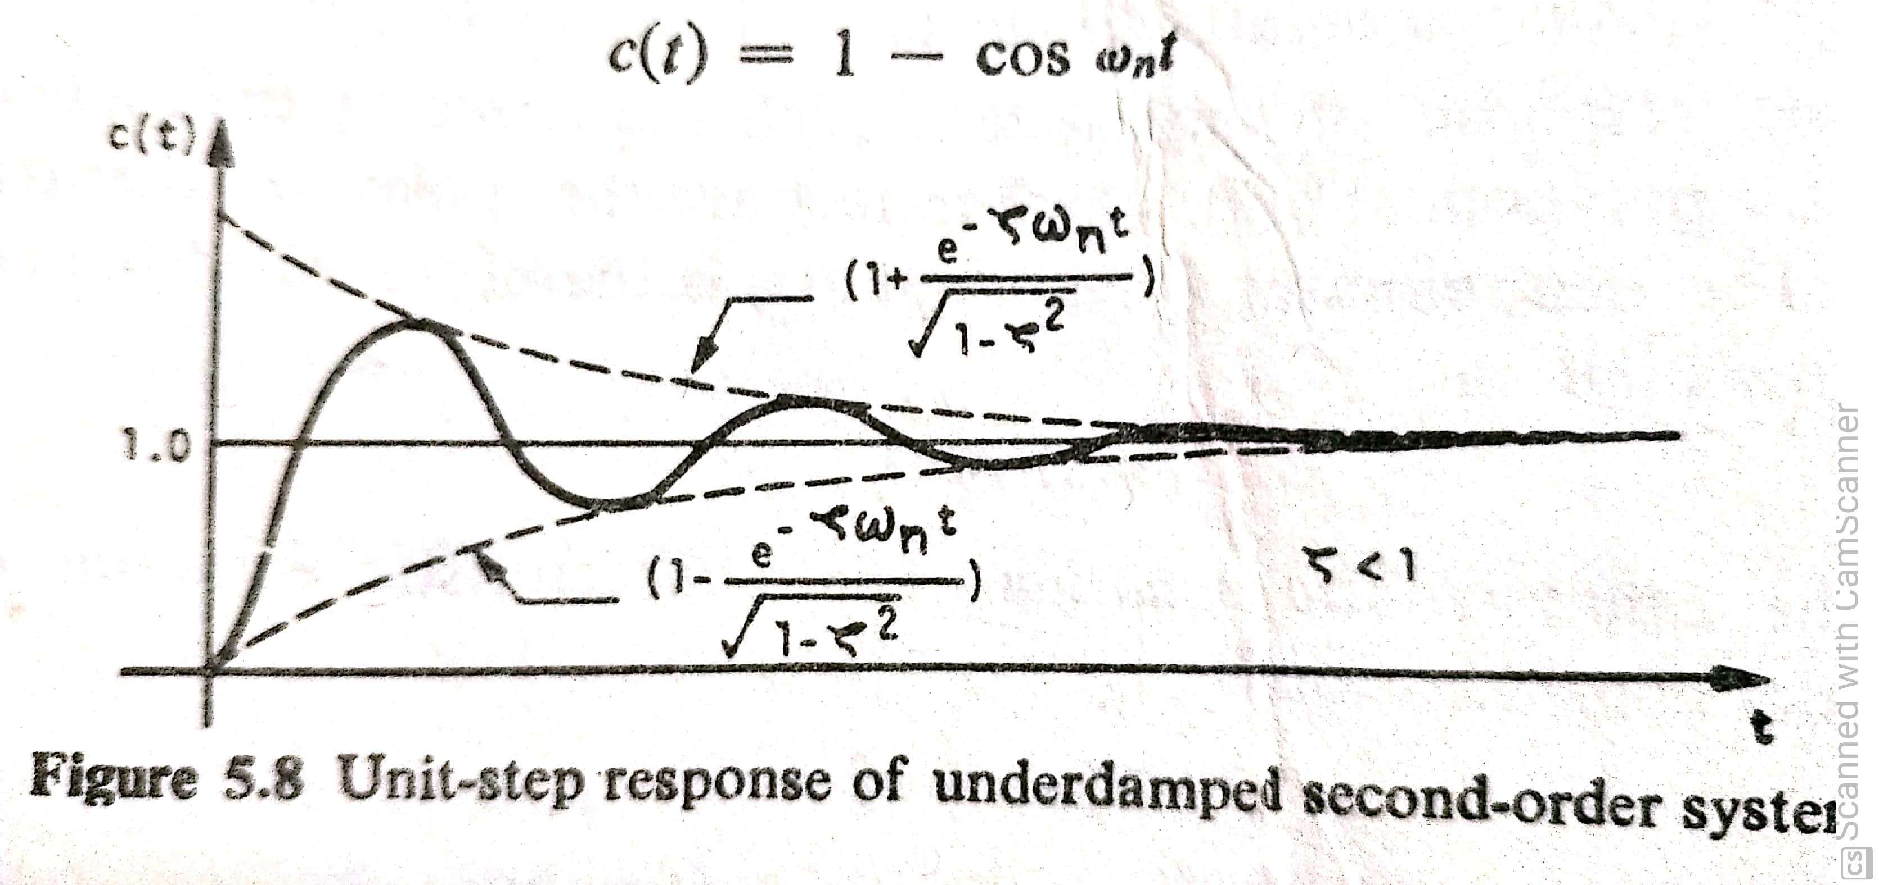
Second order systems

Slide 45
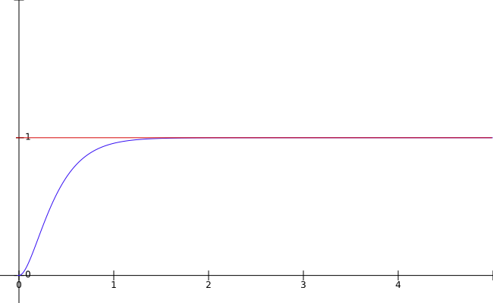


Step Response of 2nd
Order Systems
Case 3: 𝜁 = 1 − Critically damped system
_{𝜔}2
₌ 𝑛
𝑟 𝑡 , 𝑦(𝑡)
𝑌 𝑠
𝑠(𝑠² + 2𝜔_{𝑛}𝑠 + 𝜔²)
𝑛
_{𝜔}2
𝑦 𝑡
_{= ℒ}−1
𝑛
𝑠 𝑠 + 𝜔_{𝑛}
1 𝜔_{𝑛}
2
_{= ℒ}−1
1
𝑦 𝑡
− −
𝑠 𝑠 + 𝜔_{𝑛} 𝑠 + 𝜔_{𝑛}
2
𝑡
𝑦 𝑡 = 1 − 𝑒^{−𝜔𝑛𝑡} − 𝜔_{𝑛}𝑡𝑒^{−𝜔𝑛𝑡}
𝑟 𝑡 and 𝑦(𝑡) when 𝜁 = 1, 𝜔_{𝑛} = 5
45

Slide 46
Step Response of 2nd
Order Systems
Case 4: 𝜁 > 1 − Overdamped system
_{𝜔}2
_{𝜔}2
₌ 𝑛
_{= ℒ}−1
𝑛
𝑌 𝑠
⟹ 𝑦 𝑡
𝑠(𝑠 ² + 2𝜁𝜔_{𝑛}𝑠 + 𝜔²)
𝑠 𝑠 ² + 2𝜁𝜔_{𝑛}𝑠 + 𝜔²
𝑛
𝑛
𝜁
𝜁
1 +
− 1
1
𝑠
𝜁² − 1 𝜁² − 1
= ℒ
−1
−
−
2(𝑠 + 𝜁𝜔_{𝑛} − 𝜔_{𝑛} 𝜁² − 1 ) 2(𝑠 + 𝜁𝜔_{𝑛} + 𝜔_{𝑛} 𝜁² − 1 )
1 𝜁
𝑦 𝑡 = 1 − 1 +
_{𝑒}− 𝜁𝜔_{𝑛}−𝜔_{𝑛}
𝜁²−1 𝑡
2
𝜁² − 1
1 𝜁
+
_{𝑒}−(𝜁𝜔_{𝑛}+𝜔_{𝑛}
− 1
𝜁²−1 )𝑡
2
𝜁² − 1
46

Slide 47
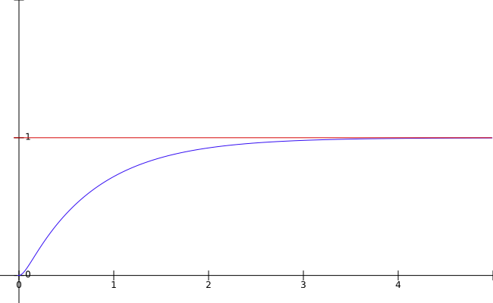


Step Response of 2nd
Order Systems
Case 4: 𝜁 > 1 − Overdamped system
𝑟 𝑡 , 𝑦(𝑡)
𝑡
𝑟 𝑡 and 𝑦(𝑡) when 𝜁 = 2, 𝜔_{𝑛} = 5
47

Slide 48
Overview
Summary :
Time response of systems
Response of 1st order and 2nd order systems to standard test inputs
Systems with different damping
effects
48

Slide 49
Time Response Specifications
And derivations, Steady state response, Steady state errors and error constants

Slide 50
Time Response Specifications : Motivation
These specifications refer to the performance indices of the step response of a system
In general, these indices are specified as a part of the design
requirements of control systems
These indices answer the following questions pertaining to step
response of a system:
How fast the system moves to follow the input ?
How oscillatory is the response (indicative of damping) ?
How long does it take to practically reach the final value ?

Slide 51
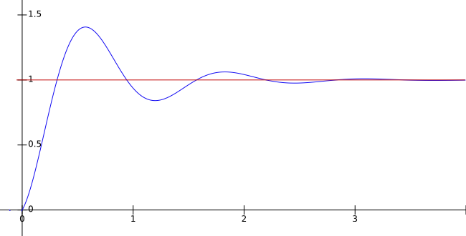
Time Response Specifications
Response of an Underdamped system
Allowable
tolerance
𝑀_{𝑝}
𝑡_{𝑑}
𝑡_{𝑟}
𝑡_{𝑝}
𝑡_{𝑠}

Slide 52
Time Response Specifications
Delay time 𝒕_{𝒅}:
– Time required for the response to reach 50% of the final value at first instance
1 + 0.7𝜁
𝑡_{𝑑} =
𝜔
𝑛
Rise time 𝒕_{𝒓}:
Time required for the response to rise from 10% to 90% of the final value for overdamped systems and 0 to 100% of the final value for underdamped systems, at first instance
Peak time 𝒕_{𝒑} :
Time required for the response to reach the peak value of time response

Slide 53
Time Response Specifications
Peak overshoot 𝑴_{𝒑} :
– It is the normalised difference between the peak value of time response and the steady state value
𝑦 𝑡_{𝑝} − 𝑦(∞)
𝑦(∞)
𝑀_{𝑝} =
Settling time 𝒕_{𝒔}:
× 100%
Time required for the response to reach and stay within a specified
tolerance band of its final value or steady state value
Usually the tolerance band is 2% or 5%
Note: 𝑡_{𝑝} and 𝑀_{𝑝} are not defined for overdamped and critically damped systems

Slide 54
Step Response of 2nd
Order Systems
1
𝑠
Unit step: 𝑅 𝑠 =
_{𝜔}2
₌ 𝑛
𝑌 𝑠
𝑠(𝑠² + 2𝜁𝜔_{𝑛}𝑠 + 𝜔²)
𝑛
0 < 𝜁 < 1 − Underdamped system
54

Slide 55
Step Response of 2nd
Order Systems
Case 2: 0 < 𝜁 < 1 − Underdamped system
_{𝜔}2
1
𝑠 𝑠 ² + 2𝜁𝜔 𝑠 + 𝜔²
₌ 𝑛
_{= ℒ}−1
𝑠 + 2𝜁𝜔
𝑌 𝑠
⟹ 𝑦 𝑡
−
𝑛
𝑠(𝑠 ² + 2𝜁𝜔_{𝑛}𝑠 + 𝜔²)
𝑛
𝜔_{𝑑}
𝑛
𝑛
1 − 𝜁²
𝜁𝜔_{𝑛}
1
𝑠 + 𝜁𝜔_{𝑛}
1 − 𝜁²
= ℒ
−1
−
−
𝑠 𝑠 + 𝜁𝜔
2 ₊
_{𝜔}2
𝑠 + 𝜁𝜔
² + 𝜔²
𝑛
𝑑
𝑛
𝑑
𝜁
𝑦 𝑡 = 1 − 𝑒^{−𝜁𝜔𝑛𝑡} cos 𝜔 𝑡 −
𝑒^{−𝜁𝜔𝑛𝑡} sin(𝜔 𝑡)
𝑑
𝑑
1 − 𝜁²
_{𝑒}−𝜁𝜔_{𝑛}𝑡
𝑦 𝑡 = 1 −
1 − 𝜁²
cos 𝜔_{𝑑} 𝑡
+ 𝜁 sin 𝜔_{𝑑} 𝑡
1 − 𝜁²
55

Slide 56
Step Response of 2nd Order Systems
_{𝑒}−𝜁𝜔_{𝑛}𝑡
𝑦 𝑡 = 1 −
[sin𝜃 cos 𝜔_{𝑑}𝑡 + cos 𝜃 sin 𝜔_{𝑑}𝑡
1 − 𝜁²
_{𝑒}−𝜁𝜔_{𝑛}𝑡
𝑦 𝑡 = 1 −
sin(𝜔_{𝑑}𝑡 + 𝜃)
1 − 𝜁²
𝑟 𝑡 , 𝑦(𝑡)
where 𝜃 = cos⁻¹ 𝜁 = sin⁻¹
1 − 𝜁²
𝑡
𝑟 𝑡 and 𝑦(𝑡) when 𝜁 = 0.5, 𝜔_{𝑛} = 5
56

Slide 57
Second order systems

Slide 58


Expression for Rise Time
Consider a 2nd order underdamped system
Rise time 𝑡_{𝑟} is the time to taken by the step response to go from 0 to 100% of the final value i.e., one
𝑒
−𝜁𝜔 𝑡
𝑦 𝑡 = 1 = 1 −
𝑛 𝑟
sin(𝜔_{𝑑}𝑡_{𝑟} + 𝜃) where 𝜃 = cos⁻¹ 𝜁
𝑟
1−𝜁²
⟹ sin 𝜔_{𝑑}𝑡_{𝑟} + 𝜃 = 0 ⟹ 𝜔_{𝑑}𝑡_{𝑟} + 𝜃 = 𝜋
𝜋 − 𝜃 𝜋 − cos⁻¹ 𝜁
𝑡_{𝑟} =
=
𝜔 1 − 𝜁²
𝜔
𝑑
𝑛

Slide 59


Expression for Peak Time
Peak time 𝑡_{𝑝} is the time taken by the step response to reach the peak value
At peak, the time derivative of response is zero
𝑑𝑦
_{𝜁𝜔𝑛𝑒}−𝜁𝜔_{𝑛}𝑡_{𝑝 𝑒}−𝜁𝜔_{𝑛}𝑡_{𝑝}
•
_{𝑡𝑝} = 0 = sin 𝜔_{𝑑}𝑡_{𝑝} + 𝜃 − 𝜔_{𝑑} cos 𝜔_{𝑑}𝑡_{𝑝} + 𝜃
𝑑𝑡
1−𝜁² 1−𝜁²
⟹ 𝜁 sin 𝜔_{𝑑}𝑡_{𝑝} + 𝜃 − 1 − 𝜁² cos 𝜔_{𝑑}𝑡_{𝑝} + 𝜃 = 0
⟹ sin 𝜔_{𝑑}𝑡_{𝑝} + 𝜃 cos 𝜃 − cos 𝜔_{𝑑}𝑡_{𝑝} + 𝜃 sin 𝜃 = 0
⟹ sin 𝜔_{𝑑}𝑡_{𝑝} = 0 ⟹ 𝜔_{𝑑}𝑡_{𝑝} = 0, 𝜋, 2𝜋, …
𝜋
𝜋
𝑡 =
=
𝑝
𝜔_{𝑑}
𝜔 1 − 𝜁²
𝑛
(corresponding to first peak)

Slide 60


Expression for Peak Overshoot
As per definition, peak overshoot for a step response,
𝑦 𝑡_{𝑝} −1
𝑀 = = 𝑦 𝑡 − 1
𝑝
1
𝑝
₋𝜁𝜔_{𝑛}𝜋
−𝜁𝜔 𝑡
𝜔_{𝑑}
𝜔_{𝑑}𝜋 _{+ 𝜃}
𝑦 𝑡 − 1 = − ^{𝑒}
𝑛 𝑝
sin 𝜔 𝑡
+ 𝜃 = − ^{𝑒}
sin
𝑝
1−𝜁²
𝑑 𝑝
1−𝜁²
𝜔_{𝑑}
𝜁𝜋
𝑒
−
1−𝜁²
−
𝜁𝜋
⟹ 𝑀 =
sin 𝜃
𝑀 = 100𝑒
1−𝜁²
𝑝
1−𝜁²
𝑝
(corresponding to first peak)

Slide 61
Expression for Settling Time
Time required for the response to reach and stay within a specified
tolerance band (take 2%) of its final value or steady state value
4
𝑡_{𝑠} = 4𝜏 = _{𝜁𝜔} (2% tolerance)
𝑛
3
𝑡_{𝑠} = 3𝜏 = _{𝜁𝜔} (5% tolerance)
𝑛
Settling time is inversely proportional to the damping ratio
As 𝜁 increases, 𝑡_{𝑠} decreases

Slide 62
Expression for Settling Time
Time required for the response to reach and stay within a specified
tolerance band (take 2%) of its final value or steady state value

Slide 63
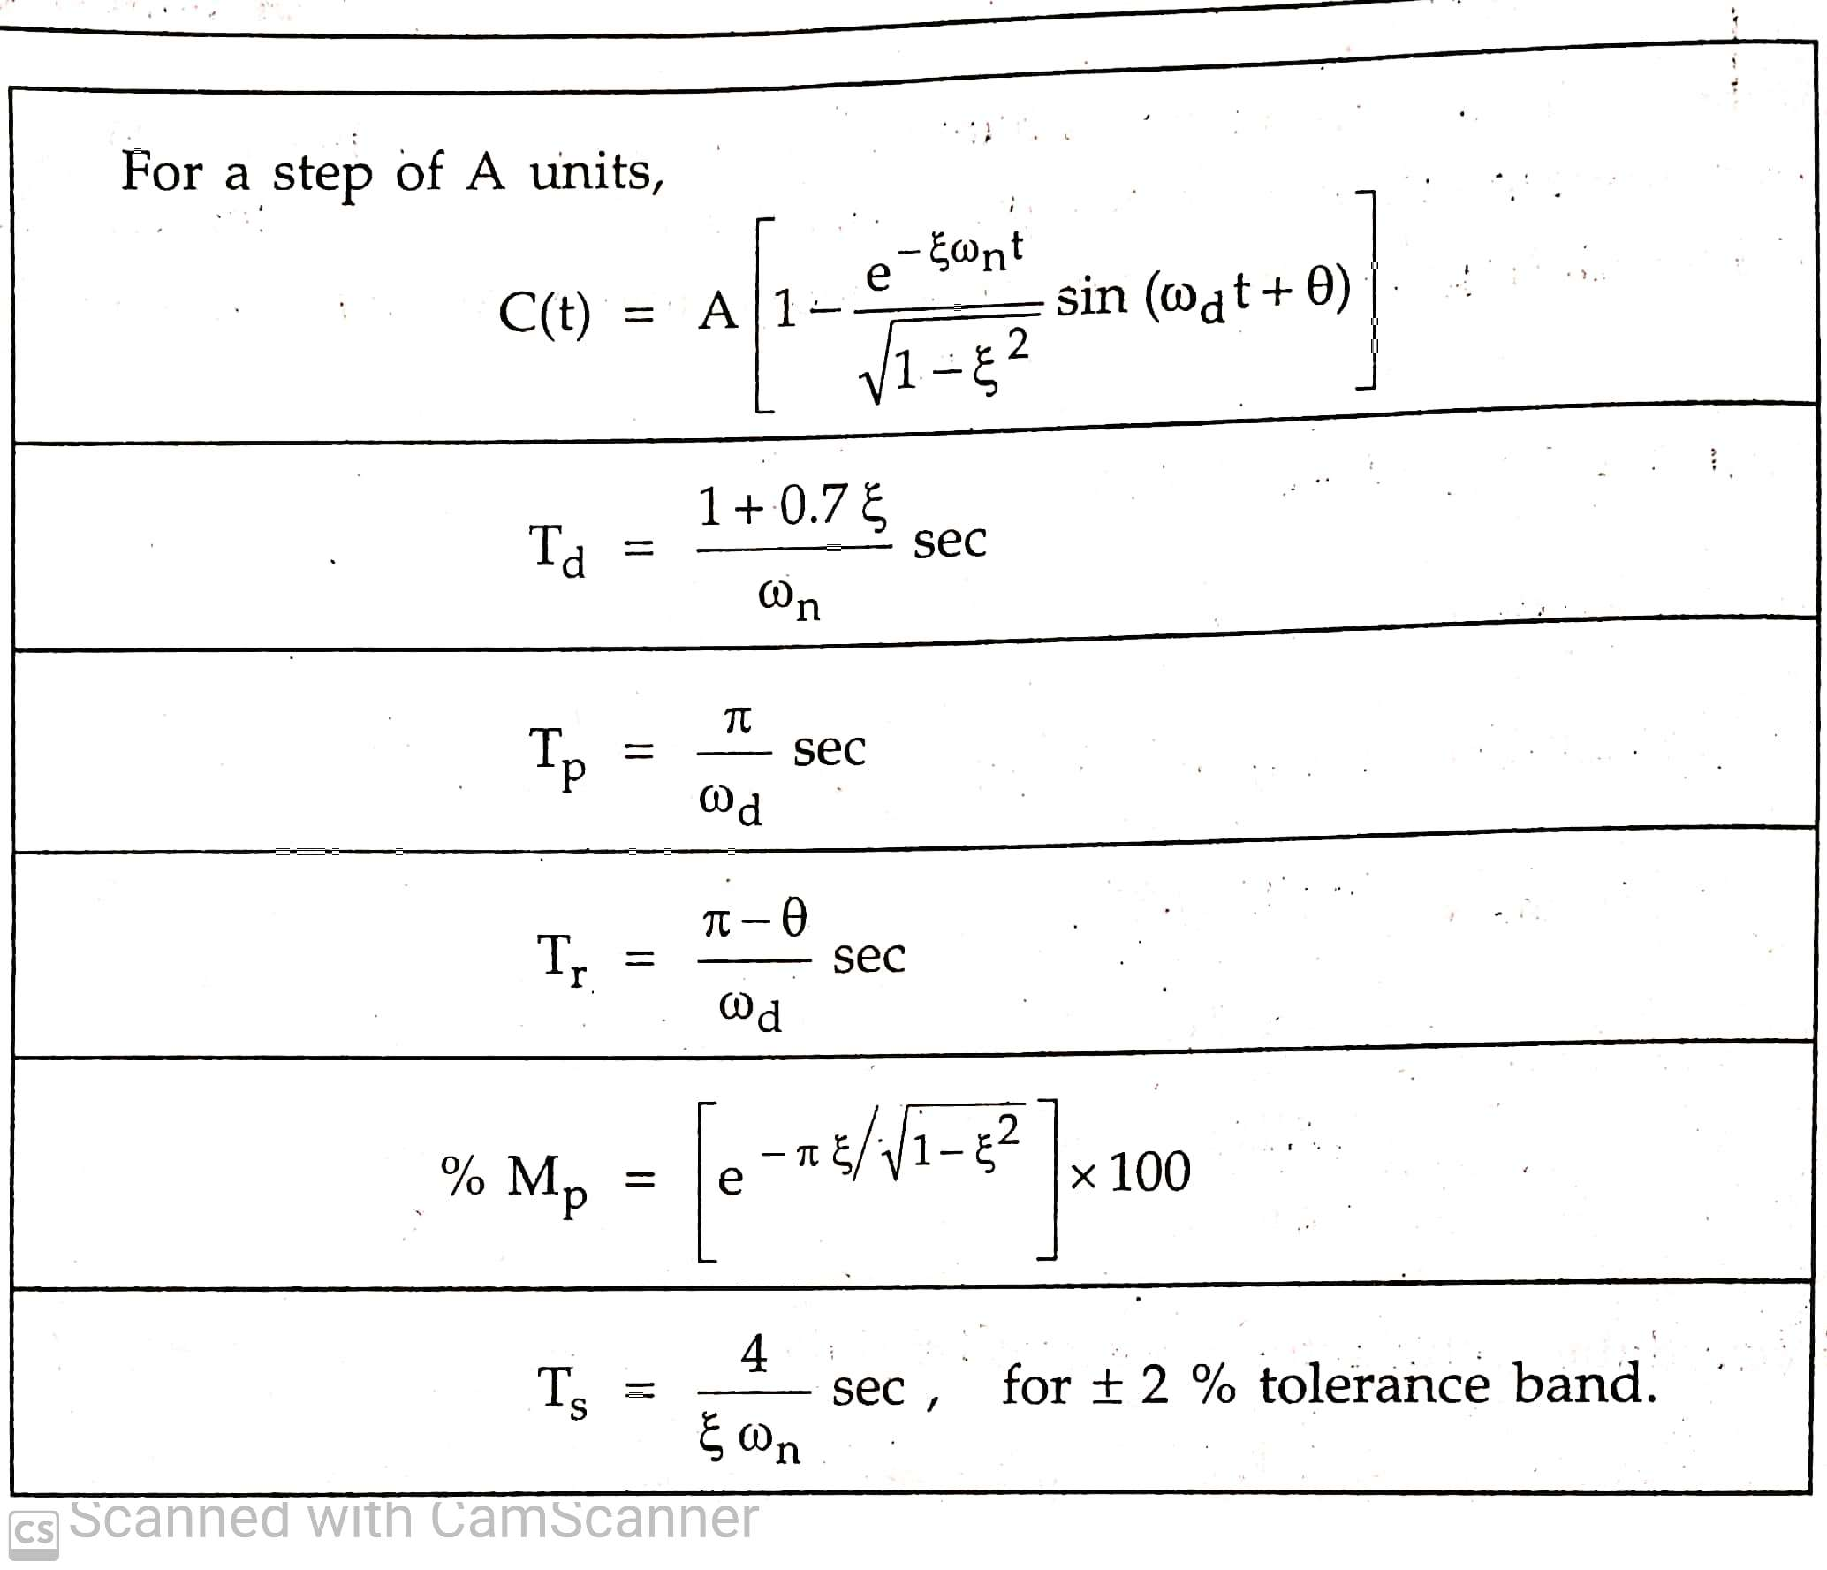
Time domain parameters

Slide 64
Application of Damped Systems
Overdamped systems:
Push button water tap shut-off valves
Automatic door closers (can be critically damped also)
Critically damped systems:
Elevatormechanism
Gun mechanism (returns to neutral position in shortest possible time)
Underdamped systems:
All string instruments, bells are underdamped to make sound appealing
Analog electrical or mechanical measuring instruments

Slide 65
Steady State Response

Slide 66
Transient and Steady State Responses
Transient response 𝒚_{𝒕𝒓}(𝒕): Part of the time response that goes to zero as time tends to be large
It is depend on system poles only and not on type of input
Steady state response 𝒚_{𝒔𝒔}(𝒕):
– Steady state response is the time response of a system after transient
practically vanishes and as time goes to infinite
It is depends on both type of input and location of system poles
Total Time response y(t)= 𝑦_{𝑡r}(𝑡) +𝑦_{𝑠𝑠} (𝑡)

Slide 67








Steady State Error
It is the error between the actual output and
the desired output as 𝑡 → ∞
𝑅(𝑠)
𝐸(𝑠)
𝑌(𝑠)
+
𝐺(𝑠)
𝑒_{𝑠𝑠} = lim 𝑒(𝑡) = lim (𝑟 𝑡 − 𝑦 𝑡 )
𝑡→∞ 𝑡→∞
By final value theorem,
−
𝑒_{𝑠𝑠} = lim 𝑒(𝑡) = lim 𝑠𝐸(𝑠)
𝑡→∞ 𝑠→0
1
𝐺𝑅 𝑅
Unity feedback system
𝐸 = 𝑅 − 𝑌 = 𝑅 −
=
1 + 𝐺 1 + 𝐺
𝑠𝑅(𝑠)
𝑒_{𝑠𝑠} = lim 𝑠𝐸(𝑠) = lim
𝑠→0
𝑠→0 1 + 𝐺(𝑠)

Slide 68
Steady State Error for Standard Inputs
₌ 1
Unit step input:
𝑅 𝑠
𝑠𝑅(𝑠)
𝑠
1
1
𝑒_{𝑠𝑠} = lim
= lim =
𝑠→0 1 + 𝐺(𝑠) 𝑠→0 1 + 𝐺(𝑠) 1 + 𝐾_{𝑝}
where 𝐾_{𝑝} = lim 𝐺 𝑠 is called position error constant
𝑠→0
Unit ramp (velocity) input:
1
𝑅 𝑠 = _{𝑠2}
1
1
1
𝑒_{𝑠𝑠} = lim
= lim =
𝑠→0 𝑠 + 𝑠𝐺(𝑠) 𝑠→0 𝑠𝐺(𝑠) 𝐾_{𝑣}
where 𝐾_{𝑣} = lim 𝑠𝐺 𝑠 is called velocity error constant
𝑠→0
Note: Velocity error is not error in the velocity but it is error in position due to ramp input

Slide 69
Steady State Error for Standard Inputs
Unit parabolic (acceleration) input: R(S)=1/𝑠
1
1
1
𝑒_{𝑠𝑠} = lim
= lim =
𝑠→0 𝑠
2
2 2
+ 𝑠 𝐺(𝑠) 𝑠→0 𝑠 𝐺(𝑠) 𝐾_{𝑎}
where 𝐾_{𝑎} = lim 𝑠²𝐺 𝑠 is called acceleration error constant
𝑠→0
The error constants 𝐾_{𝑝} , 𝐾_{𝑣} and 𝐾_{𝑎}describe the ability of a system
to reduce or eliminate steady state errors
These values mostly depend on the type of the system
As the type of the system becomes higher, more steady-state errors are eliminated

Slide 70
Features of Steady State Error
Steady state error is a measure of system accuracy
In an ideal scenario, the system should match the reference input as time progresses
It means the steady state error should be as low as possible and hence it is an important performance measure
Steady state errors depend on two factors:
Type of the reference input 𝑅 𝑠 − step, ramp or parabolic
Type of the system 𝐺(𝑠)
Steady state errors are calculated only for closed loop stable systems

Slide 71
Type of a System
Consider following pole-zero form of open loop transfer function of a system:
Term 𝑠^{𝑛} in the denominator denotes the number of the poles (𝑛)
System with 𝑛 poles at origin is called Type−𝑛 system
𝐾′ 𝑠 + 𝑧₁ 𝑠 + 𝑧₂ …
=
𝐺 𝑠
_{𝑠}𝑛
𝑠 + 𝑝₁ 𝑠 + 𝑝₂ …
– As 𝑠 → 0, 𝑠^{𝑛} term dominates in determining the steady state error
– 𝑛 also indicates the number of integrations 1/S in the system

Slide 72
Steady State Error for unit step input
Type−𝟎 system: let input is unit step find Kp and ess
𝐾′ 𝑠 + 𝑧₁
⁼ 𝑠 + 𝑝
1
𝑠 + 𝑧₂ …
𝑠 + 𝑝₂ …
𝐺 𝑠
Finite Kp=K, and Constant position steady state error (ess)=1/1+K at steady state

Slide 73
Steady State Error for unit Ramp input
Type−𝟎 system: let input is unit Ramp find Kv and ess
𝐾′ 𝑠 + 𝑧₁
⁼ 𝑠 + 𝑝
1
𝑠 + 𝑧₂ …
𝑠 + 𝑝₂ …
𝐺 𝑠
Kv=0 and infinite steady state velocity error at steady state

Slide 74
Steady State Error for unit parabolic input
Type−𝟎 system: let input is unit parabolic find Ka and ess
𝐾′ 𝑠 + 𝑧₁
⁼ 𝑠 + 𝑝
1
𝑠 + 𝑧₂ …
𝑠 + 𝑝₂ …
𝐺 𝑠
Ka=0 and infinite acceleration steady state error at steady state

Slide 75
Steady State Error for Different Systems
Type−𝟎 system:
𝐾′ 𝑠 + 𝑧₁
⁼ 𝑠 + 𝑝
1
𝑠 + 𝑧₂ …
𝑠 + 𝑝₂ …
𝐺 𝑠
𝑒 (position) = lim
1 1
=
𝑠𝑠
𝑠→0 1+𝐺(𝑠) 1+𝐾_{𝑝}
1
𝑒 (velocity) = lim ¹
= = ∞
𝑠→0 𝑠𝐺(𝑠) 0
𝑠𝑠
𝑒 (acceleration) = lim ¹
1
𝑠𝑠
𝑠→0 𝑠²𝐺(𝑠) ⁼ 0 ^{= ∞}
Constant position error, infinite velocity and acceleration errors
at steady state

Slide 76
Steady State Error for step input
Type−𝟏 system: find Kp and ess for unit step input
𝐾′ 𝑠 + 𝑧₁ 𝑠 + 𝑧₂ …
=
𝐺 𝑠
𝑠 + 𝑝₂ …
𝑠 𝑠 + 𝑝₁
Kp is infinite and Zero position error(ess=0)
18

Slide 77
Steady State Error for Ramp input
Type−𝟏 system: find Kv and ess for unit Ramp input
𝐾′ 𝑠 + 𝑧₁ 𝑠 + 𝑧₂ …
=
𝐺 𝑠
𝑠 + 𝑝₂ …
𝑠 𝑠 + 𝑝₁
Finite value of Kv=K and constant velocity error(=1/K) at steady state
18

Slide 78
Steady State Error for Unit Parabolic input
Type−𝟏 system: find Ka and ess for unit parabolic input
𝐾′ 𝑠 + 𝑧₁ 𝑠 + 𝑧₂ …
=
𝐺 𝑠
𝑠 + 𝑝₂ …
𝑠 𝑠 + 𝑝₁
value Ka =o and infinite acceleration error(ess=1/0= α) at steady state
18

Slide 79
Steady State Error for Different Systems
Type−𝟏 system:
𝐾′ 𝑠 + 𝑧₁ 𝑠 + 𝑧₂ …
=
𝐺 𝑠
𝑠 + 𝑝₂ …
= 0
𝑠 𝑠 + 𝑝₁
𝑒 (position) = lim
1 1
=
𝑠𝑠
𝑠→0 1+𝐺(𝑠) 1+∞
𝑒 (velocity) = lim ¹ = ¹
𝑠𝑠
𝑠→0 𝑠𝐺(𝑠) 𝐾_{𝑣}
𝑒 (acceleration) = lim ¹
1
𝑠𝑠
𝑠→0 𝑠²𝐺(𝑠) ⁼ 0 ^{= ∞}
Zero position
error, a constant velocity error and infinite
acceleration error at steady state
18

Slide 80
Steady State Error for Unit step input
Type−2 system: find Kp and ess for unit step input
𝐾′ 𝑠 + 𝑧₁ 𝑠 + 𝑧₂ …
=
𝐺 𝑠
_{𝑠}2
𝑠 + 𝑝₁
𝑠 + 𝑝₂ …
infinite value of Kp and Zero position Error at steady state
18

Slide 81
Steady State Error for Unit Ramp input
Type−2 system: find Kv and ess for unit ramp input
𝐾′ 𝑠 + 𝑧₁ 𝑠 + 𝑧₂ …
=
𝐺 𝑠
_{𝑠}2
𝑠 + 𝑝₁
𝑠 + 𝑝₂ …
infinite value of Kv and Zero velocity Error at steady state
18

Slide 82
Steady State Error for Unit parabolic input
Type−2 system: find Ka and ess for unit parabolic input
𝐾′ 𝑠 + 𝑧₁ 𝑠 + 𝑧₂ …
=
𝐺 𝑠
_{𝑠}2
𝑠 + 𝑝₁
𝑠 + 𝑝₂ …
finite value of Ka=K and finite acceleration Error (I/K) at steady state
18

Slide 83
Steady State Error for Different Systems
Type−𝟐 system:
𝐾′ 𝑠 + 𝑧₁ 𝑠 + 𝑧₂ …
=
𝐺 𝑠
_{𝑠}2
𝑠 + 𝑝₁ 𝑠 + 𝑝₂ …
𝑒 (position) = lim
1
=
1
= 0
𝑠𝑠
𝑠→0 1+𝐺(𝑠) 1+∞
𝑒 (velocity) = lim ¹ = ¹ = 0
𝑠𝑠
𝑠→0 𝑠𝐺(𝑠) ∞
𝑒 (acceleration) = lim ¹ = ¹
𝑠𝑠
𝑠→0 𝑠²𝐺(𝑠) 𝐾_{𝑎}
Zero position
error, zero velocity error and a constant
acceleration error at steady state
83

Slide 84
Steady State Error for Different Systems
Type−𝟐 system:
𝐾′ 𝑠 + 𝑧₁ 𝑠 + 𝑧₂ …
=
𝐺 𝑠
_{𝑠}2
𝑠 + 𝑝₁ 𝑠 + 𝑝₂ …
𝑒 (position) = lim
1
=
1
= 0
𝑠𝑠
𝑠→0 1+𝐺(𝑠) 1+∞
𝑒 (velocity) = lim ¹ = ¹ = 0
𝑠𝑠
𝑠→0 𝑠𝐺(𝑠) ∞
𝑒 (acceleration) = lim ¹ = ¹
𝑠𝑠
𝑠→0 𝑠²𝐺(𝑠) 𝐾_{𝑎}
Zero position
error, zero velocity error and a constant
acceleration error at steady state
84

Slide 85
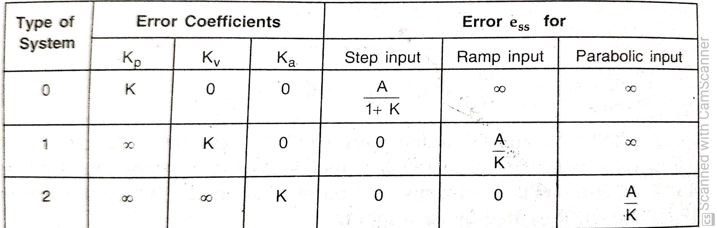
Steady state error

Slide 86
Summary :
Simplifying block diagrams of complex systems and finding transfer function
Time response analysis of 1st order and 2nd order control systems to standard test inputs
Time response specifications
86

